Slide 1
Agenda
Introduction to Agile
Agile Manifesto
Scrum Framework
Agile Estimation and Planning
Agile User Stories
Agile Metrics and Reporting

Slide 2
Agile Overview
Agile is a modern approach to project management and software development.
Agile is a project management and software development methodology that focuses on delivering value to customers quickly and iteratively.
Agile emphasizes flexibility, collaboration, and delivering value quickly.
Instead of trying to deliver everything at once (like in traditional Waterfall methods), Agile breaks work into small, manageable units called iterations or sprints.
Definition
Agile is a flexible and collaborative approach to software development where teams deliver small, working pieces of software frequently, get feedback quickly, and adapt to change rapidly.

Slide 3
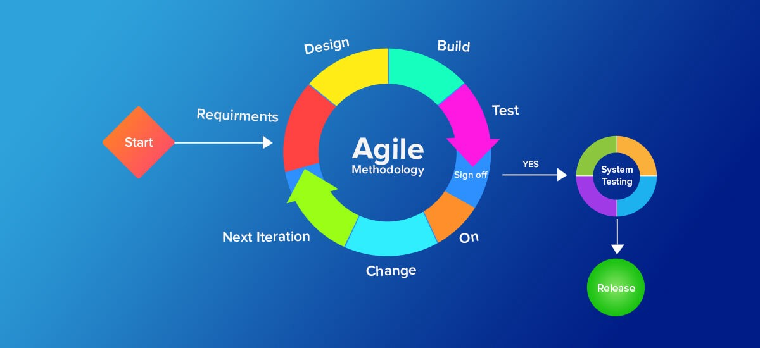
Why Agile?
Traditional models (like Waterfall) work in rigid phases — once a step is completed, going back is difficult. Agile breaks that rigidity by:
Delivering working software in short cycles.
Adapting quickly to changes.
Encouraging continuous feedback.

Slide 4
How Agile Works
Work is divided into sprints or iterations (usually 1–4 weeks).
At the end of each sprint, teams deliver a usable product increment.
Feedback is gathered and used to improve the next iteration.

Slide 5
comparison between Agile and Waterfall methodologies
Feature | Agile | Waterfall
Development Style | Iterative & incremental | Linear & sequential
Flexibility | High – embraces changing requirements | Low – changes are difficult after planning
Phases | Multiple cycles of planning, coding, testing | Single cycle with distinct phases
Customer Involvement | Continuous feedback and collaboration | Involved mostly at the beginning and end
Delivery | Frequent small releases | Single delivery at the end
Testing | Concurrent with development | After development is complete
Risk | Reduced by early issue detection | High – issues often found late
Best For | Projects with evolving or unclear requirements | Projects with well-defined, fixed scope
Documentation | Lightweight, just enough | Heavy and comprehensive
Team Communication | Daily collaboration (e.g. stand-ups) | Less frequent, more formal

Slide 6
comparison between Agile and Waterfall methodologies
Example
Agile: Building a mobile app with evolving user needs.
Waterfall: Building a bridge with fixed specifications and budget.

Slide 7
Key Characteristics of Agile
Iterative & incremental: Work is done in cycles (usually 1–4 weeks).
Customer-focused: Frequent feedback ensures the product meets user needs.
Flexible to change: Requirements can evolve even late in development.
Collaborative: Emphasizes teamwork and stakeholder involvement.
Value-driven: Prioritizes delivering the most valuable features first.

Slide 8
Benefits of Agile
Faster delivery of working software
Better alignment with customer needs
Increased ability to adapt to change
Higher team collaboration and transparency

Slide 9
Agile Manifesto
The Agile Manifesto is a foundational document for Agile software development.
The Agile Manifesto shifted the focus from rigid planning and heavy documentation to adaptive planning, continuous improvement, and faster delivery of value.
It was written in 2001 by 17 experienced developers seeking a better, more flexible way to build software.
It outlines core values and guiding principles that promote collaboration, adaptability, and customer satisfaction.
The 4 Core Values of the Agile Manifesto are as fallows
Individuals and interactions
Working software
Customer collaboration
Responding to change

Slide 10
12 Principles of Agile Manifesto
1. Customer satisfaction through early and continuous delivery
2.Welcome changing requirements, even late in development
3. Deliver working software frequently (weeks rather than months)
4. Collaboration between business people and developers
5. Build projects around motivated individuals
6. Use face-to-face conversation as the best form of communication
7. Working software is the primary measure of progress
8. Agile processes promote sustainable development
9. Continuous attention to technical excellence and good design
10. Simplicity — the art of maximizing the amount of work not done
11. Self-organizing teams produce the best results
12. Regularly reflect and adjust behavior for effectiveness

Slide 11
Popular Agile Frameworks
Scrum: Most widely used, structured around sprints.
Kanban: Visualizes workflow and limits work in progress.
XP (Extreme Programming): Focuses on engineering practices like TDD.

Slide 12
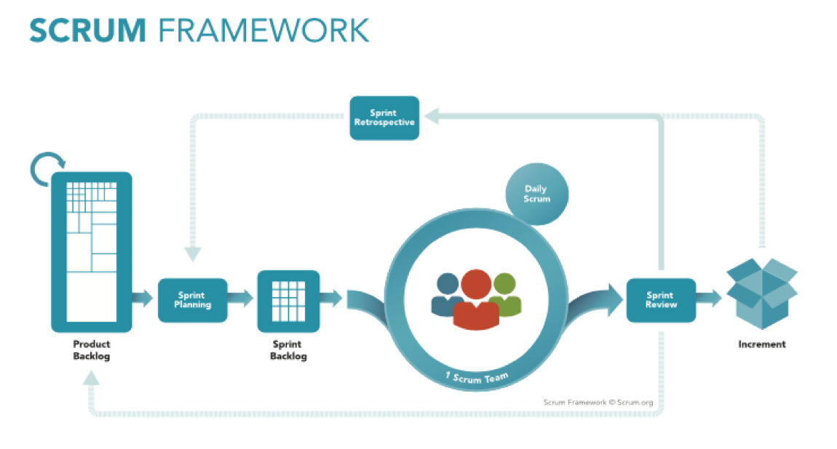
Scrum Framework
Scrum is a lightweight, Agile framework used to develop and deliver products iteratively and incrementally.
It promotes teamwork, accountability, and continuous improvement.
Scrum is especially popular in software development but is used across many industries.

Slide 13
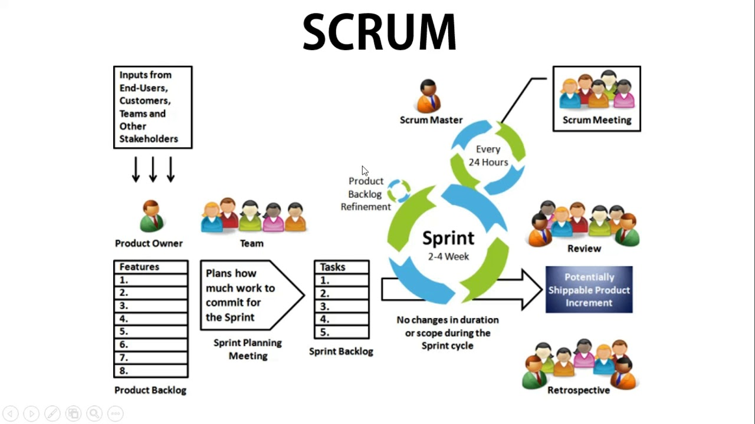
Scrum Framework

Slide 14
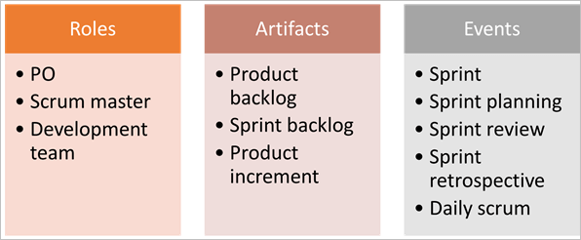
🧱 Key Components of Scrum
👥 Scrum Roles
📦 Scrum Artifacts
🔁 Scrum Events (Ceremonies)

Slide 15
Scrum Roles
1.Product Owner
Manages the Product Backlog
Represents the customer and stakeholders
Defines priorities based on business value
2. Scrum Master
Facilitates the Scrum process
Removes blockers
Coaches the team on Agile practices
3. Development Team
Cross-functional, self-organizing
Responsible for delivering a potentially shippable product increment

Slide 16
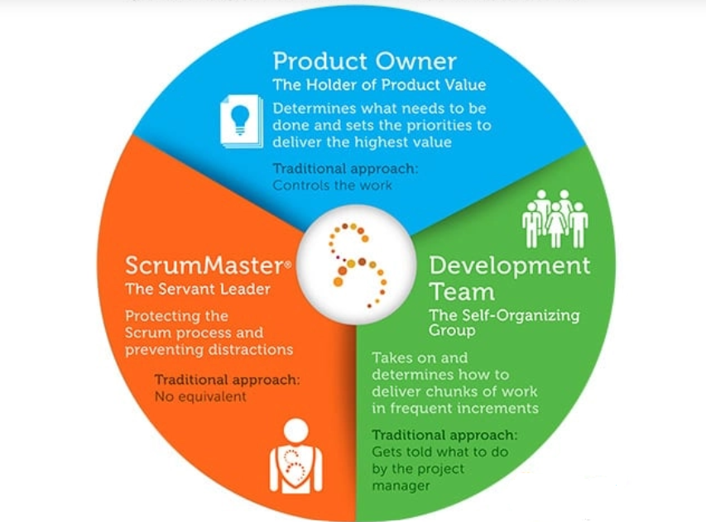
Scrum Roles

Slide 17
📦 Scrum Artifacts
In the Scrum framework, artifacts are the key deliverables that provide transparency and help track the progress of the team’s work.
Each artifact is designed to maximize visibility and enable empirical decision-making.
1. Product Backlog
2. Sprint Backlog
3. Increment

Slide 18
📦 Scrum Artifacts
1. Product Backlog
A dynamic and evolving list of everything that might be needed in the product
Includes features, bugs, technical work, and knowledge acquisition
Ordered by value, risk, size, and priority
Continuously refined through Backlog Grooming/Refinement
2. Sprint Backlog
Contains:
Items selected for the Sprint (from Product Backlog)
A plan for delivering them (e.g., tasks)
Owned and updated daily by the Development Team
Highly visible and tracked using boards (e.g., Kanban)
3. Increment
The usable, potentially releasable product output at the end of a Sprint
Must meet the Definition of Done
Represents a step toward the Product Goal
Multiple increments can be created in a Sprint, but all must be integrated and meet “Done”
Owned by: Development Team
Includes: All completed items that meet the Definition of Done

Slide 19
📦 Scrum Artifacts
Artifact | Purpose | When Used
Product Backlog | Prioritize and track work to do | Throughout the product life
Sprint Backlog | Focus for the current Sprint | Sprint Planning → Daily
Increment | Demonstrate progress | Sprint Review + Release-ready

Slide 20
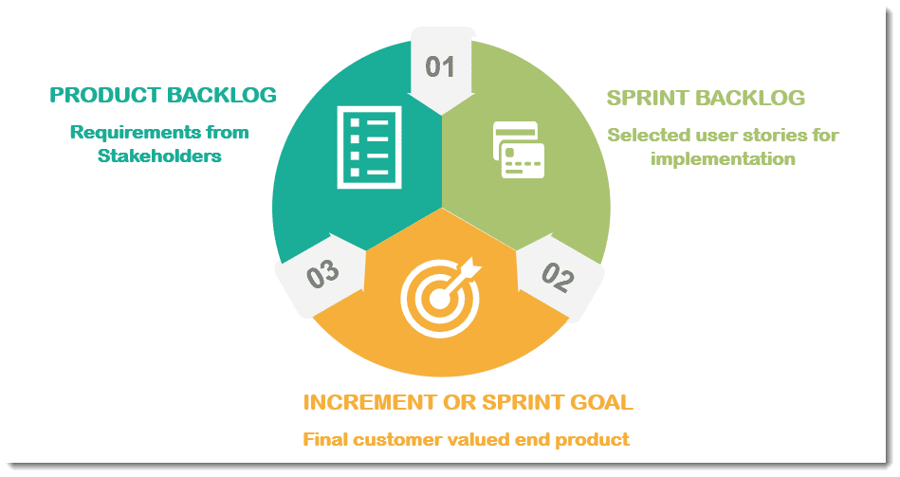
📦 Scrum Artifacts

Slide 21
🔁 Scrum Events (Ceremonies)
Scrum defines five official events (also known as ceremonies) that create a rhythm for the team, ensure regular inspection and adaptation, and help teams stay aligned and focused.
🗓️ 1. Sprint
🧠 2. Sprint Planning
🔄 3. Daily Scrum (Daily Stand-up)
✅ 4. Sprint Review
🔍 5. Sprint Retrospective

Slide 22
🔁 Scrum Events (Ceremonies)
🗓️ 1. Sprint
What: The core cycle in Scrum — a time-boxed iteration (usually 1–4 weeks)
Goal: Deliver a potentially shippable product increment
Fixed length: Always the same duration throughout the project
Includes all the other Scrum events
🧠 2. Sprint Planning
When: At the start of each Sprint
Who: Product Owner, Scrum Master, Development Team
Purpose:
Decide what can be delivered in the Sprint (Sprint Goal)
Plan how the work will be done
📌 Inputs: Product Backlog, team capacity 📌 Outputs: Sprint Backlog, Sprint Goal

Slide 23
🔁 Scrum Events (Ceremonies)
🔄 3. Daily Scrum (Daily Stand-up)
When: Every day, same time and place (15 minutes)
Who: Development Team
Purpose:
Sync up and plan for the next 24 hours
Identify obstacles
💬 Common questions:
What did I do yesterday?
What will I do today?
Are there any blockers?

Slide 24
🔁 Scrum Events (Ceremonies)
✅ 4. Sprint Review
When: At the end of the Sprint
Who: Scrum Team + stakeholders
Purpose:
Demonstrate the Increment
Collect feedback and discuss next steps
Update the Product Backlog
🎯 Focused on: Inspecting product progress

Slide 25
🔁 Scrum Events (Ceremonies)
🔍 5. Sprint Retrospective
When: After the Sprint Review and before the next Sprint
Who: Scrum Team only
Purpose:
Reflect on the Sprint process
Identify what went well, what didn’t, and how to improve
🛠️ Leads to continuous improvement

Slide 26
🔁 Scrum Events (Ceremonies)
Event | Duration | Purpose
Sprint | 1–4 weeks | Deliver usable product increment
Sprint Planning | ~2 hours/week of Sprint | Define work and goal for the Sprint
Daily Scrum | 15 minutes daily | Sync and identify obstacles
Sprint Review | ~1 hour/week of Sprint | Demo work and gather feedback
Sprint Retrospective | ~45 mins/week of Sprint | Improve processes and collaboration

Slide 27
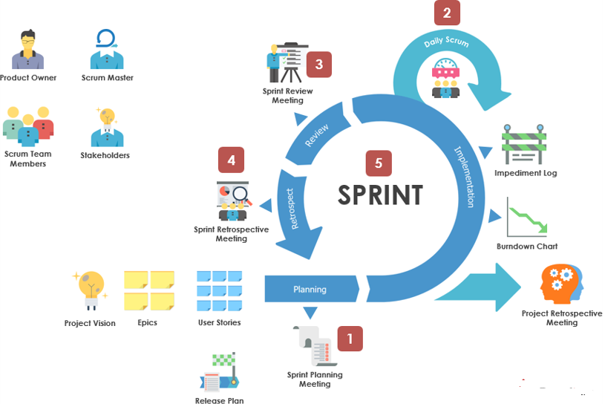
🔁 Scrum Events (Ceremonies)

Slide 28
🔄 Scrum Workflow Summary
Product Owner refines and prioritizes the Product Backlog
Team selects items for the Sprint Backlog in Sprint Planning
Team works through items during the Sprint
Daily Scrum Meetings ensure progress
Team demonstrates work in Sprint Review
Process is evaluated in the Sprint Retrospective

Slide 29
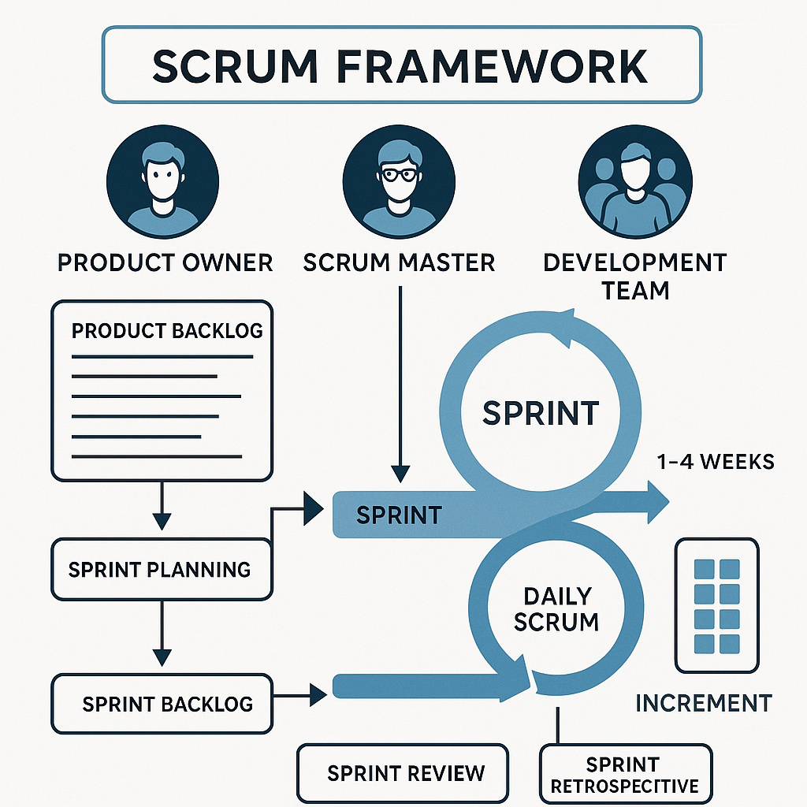
🔄 Scrum Workflow Summary

Slide 30
📊 Agile Estimation and Planning
Agile estimation is the process of evaluating the effort, complexity, or time required to complete a task or user story.
🔑 Why Estimate in Agile?
Prioritize work effectively
Plan sprints and releases
Understand team capacity
Improve predictability and delivery

Slide 31
📊 Agile Estimation and Planning
📊 Common Agile Estimation Techniques
1. Story Points
2. T-Shirt Sizes
3. Planning Poker
4. Affinity Estimation

Slide 32
🧮 Agile Estimation
1. Story Points
What: Abstract units that reflect effort + complexity + risk
How: Estimate relatively (e.g., "This story feels twice as complex as that one")
Scale: Often uses Fibonacci sequence (1, 2, 3, 5, 8, 13, ...)
2. T-Shirt Sizes
What: Simple sizing: XS, S, M, L, XL
Used for: Initial high-level estimates when details are lacking
Often converted to story points later
3. Planning Poker
How: Team members estimate stories individually using cards (or apps), then reveal and discuss differences
Encourages discussion and consensus
Team members show their estimates simultaneously to avoid bias
Discussion happens if there's a wide spread
4. Affinity Estimation
How: Quickly group user stories by relative size
Used when: Estimating large backlogs efficiently

Slide 33
📅 Agile Planning
Agile planning focuses on flexibility, collaboration, and delivering value continuously.
Unlike traditional project planning that relies on fixed long-term schedules, Agile planning adapts as the team learns more during development.

Slide 34
🧭 Key Levels of Agile Planning
Agile planning happens in layers, from high-level vision to daily execution:
🔹 1. Product Vision
Describes why the product exists
Sets long-term objectives
Typically created by the Product Owner and stakeholders
🔹 2. Product Roadmap
A high-level timeline of upcoming features or releases
May include Epics, key milestones, and dependencies
An Epic is a large body of work that can be broken down into smaller tasks known as User Stories. In Agile, epics are used to organize and structure product features or requirements that are too big to complete in a single sprint.
🔹 3. Release Planning
Estimates what features can be delivered in a release
Involves velocity, team capacity, and business priorities

Slide 35
🧭 Key Levels of Agile Planning
🔹 4. Sprint Planning (Iteration Planning)
Happens at the start of each Sprint
The team selects Product Backlog items to work on
The Sprint Goal is defined
Tasks are identified and estimated (if not already)
🔹 5. Daily Standups
Daily 15-minute meetings to plan and coordinate
Keeps the team aligned and responsive to change

Slide 36
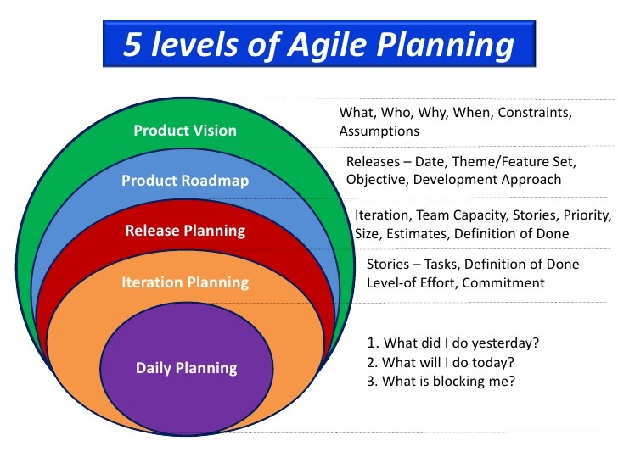
🧭 Key Levels of Agile Planning

Slide 37
📊 Agile Tools for Planning
Jira, Azure DevOps, Trello, ClickUp
Burnup/Burndown charts
Product backlogs, sprint boards, roadmaps

Slide 38
🗓️ Agile Planning
Level | Purpose | Time Horizon
1. Product Vision | Set the overall direction and goals | Entire product
2. Roadmap Planning | Define high-level features and timeline | Months to quarters
3. Release Planning | Plan features for the upcoming release | Weeks to months
4. Iteration (Sprint) Planning | Plan work for the next Sprint | 1–4 weeks
5. Daily Planning | Coordinate tasks and resolve issues | Day-to-day

Slide 39
📝 Agile User Stories
User stories are the building blocks of Agile development.
User stories are short, simple descriptions of a feature told from the end-user’s perspective.
They help Agile teams understand what the user needs, why they need it, and what value it provides.
🔍 What is a User Story?
A user story describes:
"Who wants what and why.“
"As a [type of user], I want [an action or feature], so that [benefit or value]."
✅ Typical Format
As a [type of user],
I want [some goal],
so that [some reason].
Example:
As a registered user,
I want to reset my password,
so that I can regain access if I forget it.
As a customer
I want to receive email notifications after placing an order,
so that I can confirm my purchase.

Slide 40
🧱 Structure of a Good User Story
Title – A short name (e.g., “Add email notification”)
Description – The user story in sentence format
Acceptance Criteria – Conditions that must be met for the story to be considered "done“
Story Points (Optional) – Estimate of size or complexity

Slide 41
🎯 Characteristics of a Good User Story — INVEST Model
Each story should be:
I | Independent – Can be developed/tested separately
N | Negotiable – Flexible, not a detailed contract
V | Valuable – Delivers value to users or customers
E | Estimable – Team can estimate the effort
S | Small – Sized appropriately for one Sprint
T | Testable – Clear criteria to know when it's done

Slide 42
🎯 Characteristics of a Good User Story — INVEST Model
Each story should be:
Letter | Meaning | Description
I | Independent | Self-contained and not dependent on others
N | Negotiable | Not a fixed contract; open to discussion
V | Valuable | Delivers value to the user or customer
E | Estimable | Small enough to be estimated
S | Small | Fits within a single sprint
T | Testable | Clear enough to write tests against it

Slide 43
📋 Acceptance Criteria Example
For a login feature:
User can enter email and password
System validates credentials
Displays an error message on failure
Redirects on successful login

Slide 44
Agile user stories
🖥️ Web Application (e.g., E-Commerce Site)
1. As a customer,
I want to filter products by price and rating,
so that I can find the best items within my budget.
2. As an admin,
I want to update product details from the dashboard,
so that I can keep inventory accurate.

Slide 45
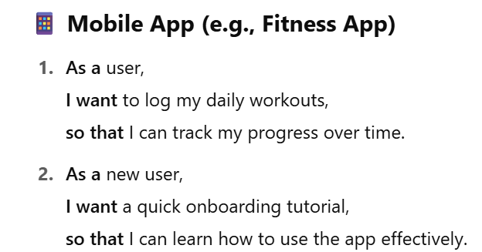
Agile user stories

Slide 46
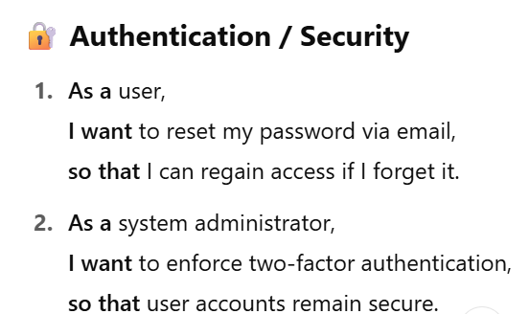
Agile user stories

Slide 47
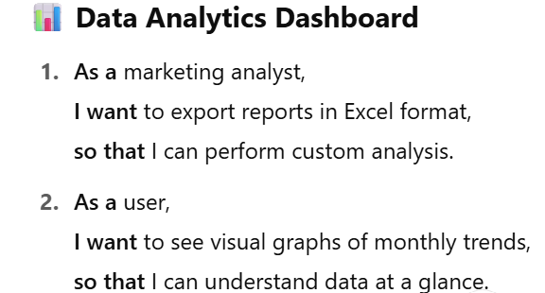
Agile user stories

Slide 48
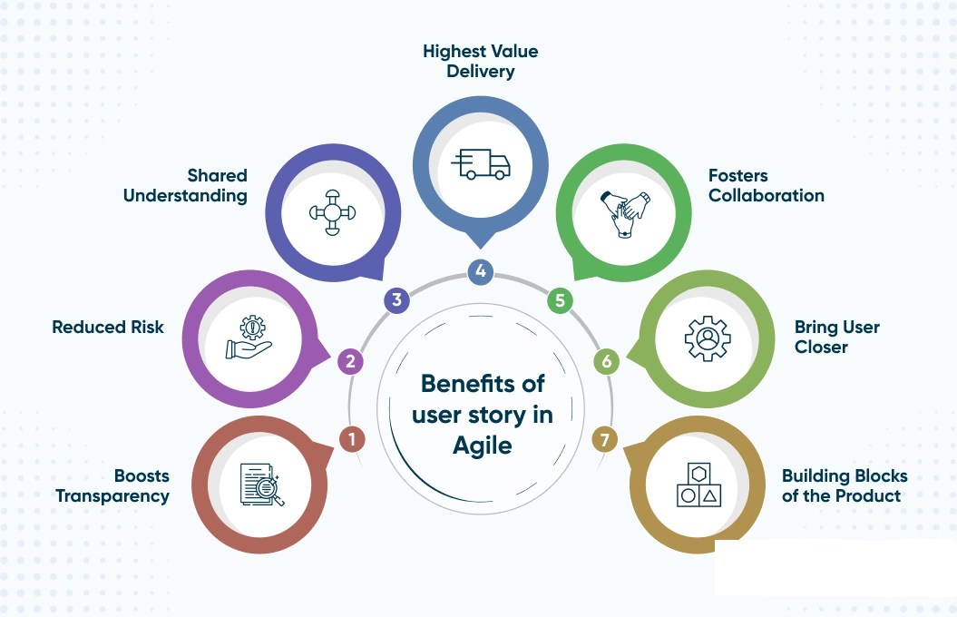
Agile user stories
✍️ Tips for Writing Better User Stories
Focus on user needs, not system functionality
Collaborate with the team and stakeholders
Keep them short, clear, and testable
Break down large stories into smaller ones (slicing)

Slide 49
📈 Agile Metrics and Reporting
Agile metrics help teams and stakeholders measure progress, quality, and performance during Agile development.
Agile metrics help teams and stakeholders track progress, efficiency, and product quality in Agile projects.
They provide insight into how well the team is delivering value, identifying bottlenecks, and improving over time.
These metrics are lightweight, value-driven, and focus on continuous improvement rather than rigid targets.

Slide 50
🔢 Key Agile Metrics
1. Velocity
2. Sprint Burndown Chart
3. Release Burndown Chart
4. Cumulative Flow Diagram (CFD)
5. Lead Time & Cycle Time
6. Team Happiness / Health Metrics
7. Defect Density / Escaped Defects

Slide 51
🔢 Key Agile Metrics
1. Velocity
What: Amount of work a team completes in a Sprint (measured in story points or tasks)
Why: Predicts how much work a team can handle in future sprints
📈 Used for: Sprint planning, release forecasting
2. Sprint Burndown Chart
What: Visual chart showing remaining work vs. time in a Sprint
Why: Tracks progress during the Sprint; shows if the team is on track
📉 Ideal Trend: A smooth decline toward zero work remaining by the end of the Sprint

Slide 52
🔢 Key Agile Metrics
3. Release Burndown Chart
What: Shows progress toward completing a release
Why: Helps visualize if the team is on track to meet a release deadline
🗓️ Timeframe: Covers multiple Sprints
4. Cumulative Flow Diagram (CFD)
What: Shows the status of tasks (e.g., To Do, In Progress, Done) over time
Why: Identifies bottlenecks and flow issues
📊 Goal: A consistent “flow” of tasks moving from left to right

Slide 53
🔢 Key Agile Metrics
5. Lead Time & Cycle Time
Lead Time: Time from request to delivery
Cycle Time: Time from when work begins to when it’s completed
⏱Why: Shorter times indicate faster delivery and less waiting
6. Team Happiness / Health Metrics
What: Subjective surveys about team morale, workload, clarity, etc.
Why: Happy teams = productive teams
😊 Can be measured via retro feedback or pulse surveys
7. Defect Density / Escaped Defects
Defect Density: Bugs per unit of work or time
Escaped Defects: Bugs found after release
🐞 Why: Measures product quality and test coverage

Slide 54
🔢 Key Agile Metrics
Metric | Purpose
Velocity | Estimate team capacity
Sprint Burndown | Monitor daily progress
Release Burndown | Track toward release goals
Cumulative Flow Diagram | Spot workflow issues
Lead/Cycle Time | Measure delivery speed
Team Health Metrics | Gauge morale and alignment
Defect Metrics | Monitor product quality

Slide 55
📊 Agile Reporting
Agile reporting provides teams and stakeholders with clear, real-time insights into progress, productivity, and quality.
The goal isn’t just documentation — it’s to enable better decisions, enhance transparency, and support continuous improvement.

Slide 56
📋 Types of Agile Reports
1. Sprint Report
What: Summary of what was planned vs. completed in a sprint
Who Uses It: Scrum teams and stakeholders
Includes: Story completion, blockers, velocity, sprint goals
2. Burndown Chart
What: Shows remaining work over time during a sprint or release
Purpose: Visualize pace and detect if you're on track
Ideal For: Daily standups, sprint reviews
3. Burnup Chart
What: Tracks work completed vs. total scope
Better For: Showing scope changes over time

Slide 57
📋 Types of Agile Reports
4. Velocity Chart
What: Measures how many story points are completed per sprint
Helps With: Sprint capacity planning and forecasting
5. Cumulative Flow Diagram
What: Tracks the number of items in each workflow state
Reveals: Bottlenecks and WIP (work-in-progress) limits
6. Epic/Release Progress Reports
What: Tracks progress of features (epics) or releases
Useful For: Product Owners, stakeholders, and leadership

Slide 58
📋 Types of Agile Reports
7. Defect Reports
What: Shows defect counts by severity, source, or module
Purpose: Maintain product quality and testing effectiveness

Slide 59
📋 Types of Agile Reports
Report Type | Purpose | Primary Audience
Sprint Burndown Chart | Track daily work progress in a sprint | Development Team, Scrum Master
Velocity Chart | Understand team delivery capacity | Product Owner, Team
Cumulative Flow Diagram (CFD) | Visualize work in different stages | Scrum Master, Project Manager
Release Burndown Chart | Show progress toward completing a release | Stakeholders, Product Owner
Epic/Feature Progress | Monitor large feature or epic progress | Product Owner, Stakeholders
Bug/Defect Reports | Monitor defect trends | QA, Dev Team
Team Health Surveys | Assess team morale and alignment | Scrum Master, Team Lead

Slide 60
📊 Common Agile Reporting Tools
Most Agile teams use tools that generate reports automatically:
Jira
Azure DevOps
ClickUp
Trello (Power-Ups required)
Monday.com
Rally (CA Agile Central)

Slide 61
🧠 Characteristics of Good Agile Reports
Real-time and up-to-date
Easy to interpret at a glance
Encourage actionable conversations
Tailored to the audience (team vs. management)

Slide 62
✅ Examples of Report Use
Sprint Review: Use a burndown chart to discuss what was completed vs. planned
Retrospective: Use a CFD to spot where work got stuck
Planning: Use velocity trends to plan upcoming sprints and releases
Stand-ups: Use issue status boards (like Kanban) to track daily tasks

Slide 63
Conclusion
Introduction to Agile
Agile Manifesto
Scrum Framework
Agile Estimation and Planning
Agile User Stories
Agile Metrics and Reporting
“Thank you! Any questions?”

